Slide 1
CMSC 449/691 Malware Analysis
Lecture 9
Cdecl and C Code Constructs
Revised Spring 2025

Slide 2
The Cdecl Calling Convention

Slide 3
What is Cdecl?
The calling convention for the C programming language
Calling conventions determine
Order in which parameters are placed onto the stack
Which registers are used/preserved for the caller
How the stack in general is handled

Slide 4
Simple Cdecl Example – Code
What actually happens on the stack when this program is run?
What variables are allocated first?
How does the stack grow?
int myFunc(char *par1, int par2)
{
char local1[64];
int local2;
return 0;
}
int main(int argc, char **argv)
{
myFunc(argv[1], atoi(argv[2]);
return 0;
}

Slide 5
Simple Cdecl Example – Calling
← EBP
PUSH par2
PUSH par1
PUSH EIP
PUSH EBP
MOV EBP, ESP
SUB ESP, 68
64 bytes for chars
4 bytes for integer
Previous function’s Stack Frame (local vars, etc.)
← ESP
par2
par1
Return Address (from EIP)
Previous function’s EBP
local1
local2

Slide 6
Simple Cdecl Example – Returning
MOV ESP, EBP
POP EBP
RETN (POP EIP)
Previous function’s Stack Frame (local vars, etc.)
par2
par1
Return Address (from EIP)
Previous function’s EBP
The caller handles popping parameters upon return.
← EBP
local1
local2
← ESP

Slide 7
C Code Constructs

Slide 8
C Code Constructs
Code construct – Code abstraction level that defines a particular operation, without specifying how it works
Loops, if statements, function calls, arrays, etc.
Important to recognize what these look like in assembly!

Slide 9
Local and Global Variables
Local variables can only be accessed in the function they are defined inside of
Global variables can be accessed from anywhere in a program

Slide 10
Global Variable Example - C
int x = 1;
int y = 2;
void main() {
x = x + y;
printf("Total = %d\n", x);
}
From Practical Malware Analysis ch.6

Slide 11
Global Variable Example - Assembly
MOV EAX, dword_40CF60
ADD EAX, dword_40C000
MOV dword_40CF60, EAX
MOV ECX dword_40CF60
PUSH ECX
PUSH offset aTotalD ;"total = %d\n"
CALL printf
From Practical Malware Analysis ch.6

Slide 12
Local Variable Example - C
void main(){
int x = 1;
int y = 2;
x = x + y;
printf("Total = %d\n", x);
}
From Practical Malware Analysis ch.6

Slide 13
Local Variable Example - Assembly
MOV dword ptr [EBP-4], 1
MOV dword ptr [EBP-8], 2
MOV EAX, [EBP-4]
ADD EAX, [EBP-8]
MOV [EBP-4], EAX
MOV ECX, [EBP-4]
PUSH ECX
PUSH offset aTotalD ; "total = %d\n"
CALL printf
From Practical Malware Analysis ch.6

Slide 14
Identifying Arrays in Assembly
int i = 9;
char arr[64];
arr[i] = 50;
SUB ESP, 0x44 ; Reserve 68 bytes on stack
MOV [EBP-0x4], 0x9
MOV EAX, [EBP-0x4]
MOV EBX, 0x32
MOV [EBP-0x44+EAX*4], EBX

Slide 15
If / Else Statement in Assembly
CMP EAX, EBX
JNZ short loc_40102B
PUSH offset aEAXeq_ ; "EAX == EBX\n"
CALL printf
JMP short loc_401038
loc_40102B:
PUSH offset aEAXneq_ ; "EAX != EBX\n"
call printf
loc_401038:
From Practical Malware Analysis ch.6

Slide 16
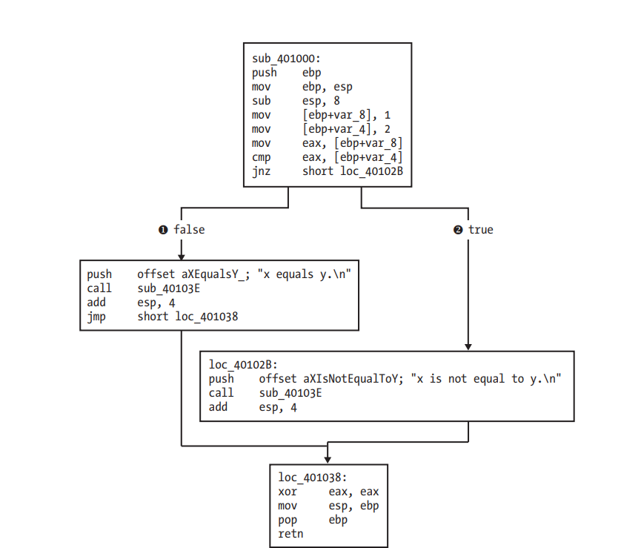
Side Note- Disassembly Graphs
Tools such as IDA Pro and Ghidra help visualize branching and loops
This is another example of an if/else statement in assembly
Much easier to understand how the control flow works!
From Practical Malware Analysis ch.6

Slide 17
Recognizing While Loops in Assembly
MOV EAX, -1
loc_401044:
CMP EAX, 0
JNZ short loc_401063
CALL myFunc
JMP short loc_401044
loc_401063
...
RET
From Practical Malware Analysis ch.6

Slide 18
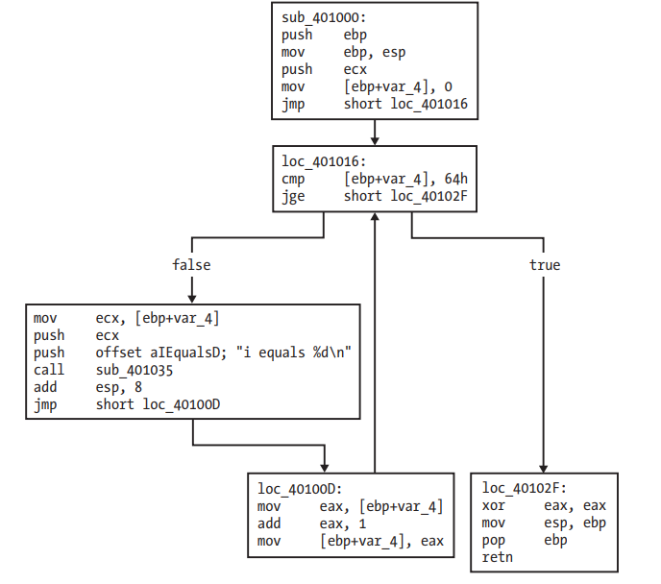
Recognizing For Loops in Assembly
void loop_func(){
int i;
for(i = 0; i < 100; i++){
printf("i equals %d\n");
}
return;
}
From Practical Malware Analysis ch.6

Slide 19
If-Style Switch Statements
switch(i){
case 0:
printf("i = %d", i);
break;
case 1:
printf("i = %d", i);
break;
default:
break;
}
From Practical Malware Analysis ch.6

Slide 20
If-Style Switch Statements
CMP [EBP-0x4], 0
JZ short loc_401027
CMP [EBP-0x4], 1
JZ short loc_40103D
jmp short loc_401067 ; Default
loc_401027
...
loc_40103D
...
From Practical Malware Analysis ch.6

Slide 21
Jump Table Switch Statements
MOV EDX, [EBP-0x4]
JMP ds:off_401088[EDX*4]
loc_40106E ; case 0
...
loc_401042 ; case 1
...
loc_401058 ; case 2
...
401088 00 40 10 6E
40108C 00 40 10 42
401090 00 40 10 58
From Practical Malware Analysis ch.6
Notes:
Defaults need to be handled before the jump table

Slide 22
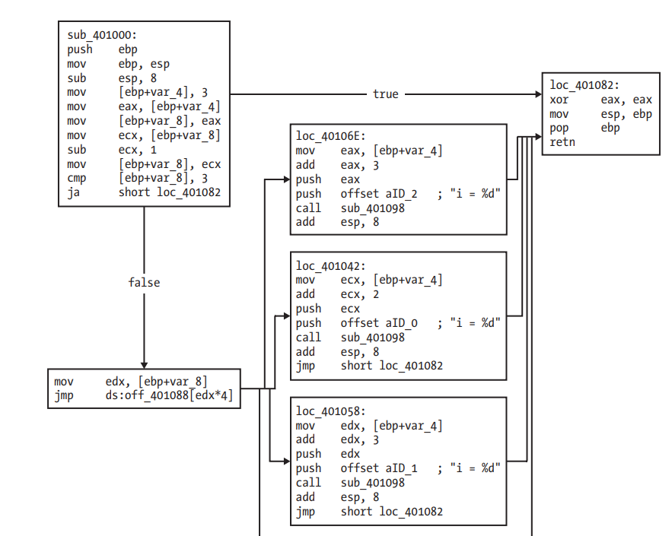
Jump Tables in Disassembly Graphs
From Practical Malware Analysis ch.6

